Slide 1

Capstone Project – Retail Analysis

Slide 2
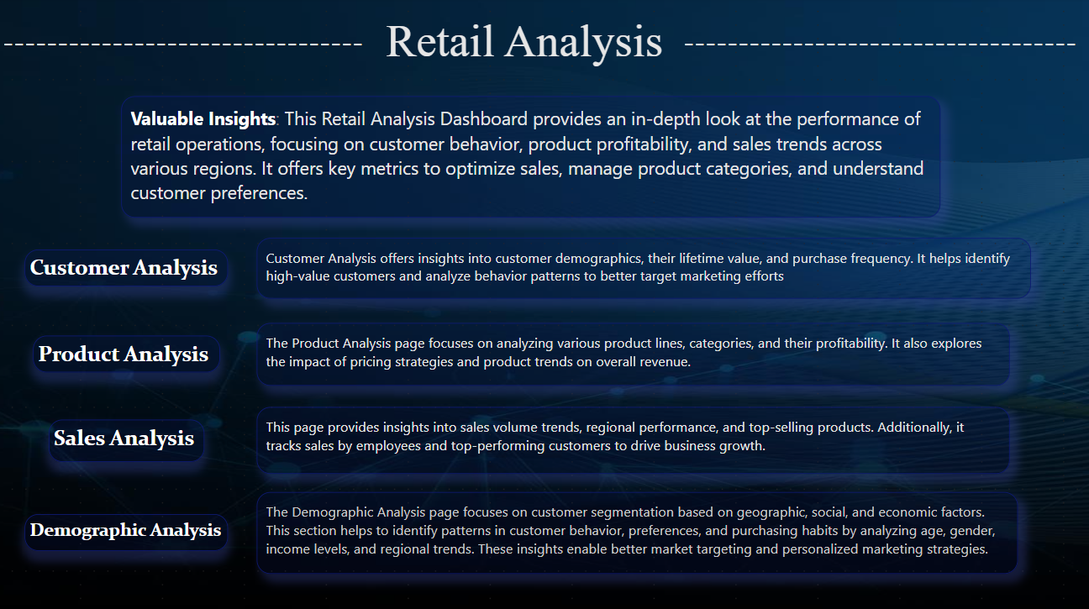

Slide 3

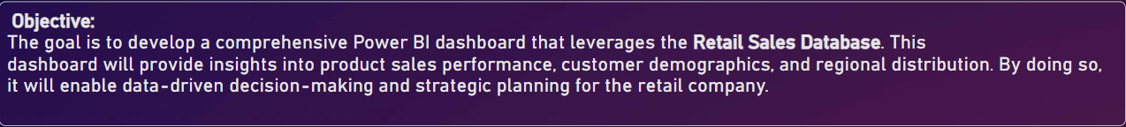
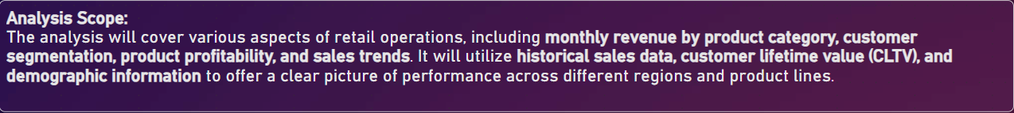


Slide 4
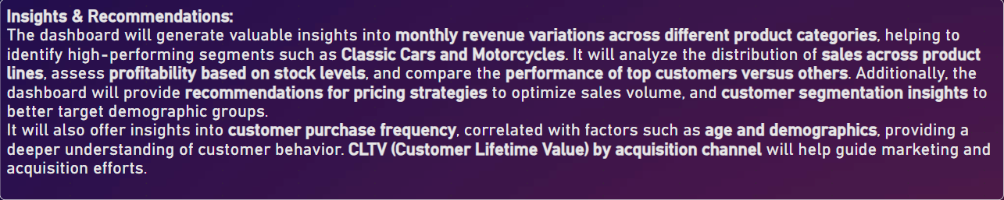


Slide 5
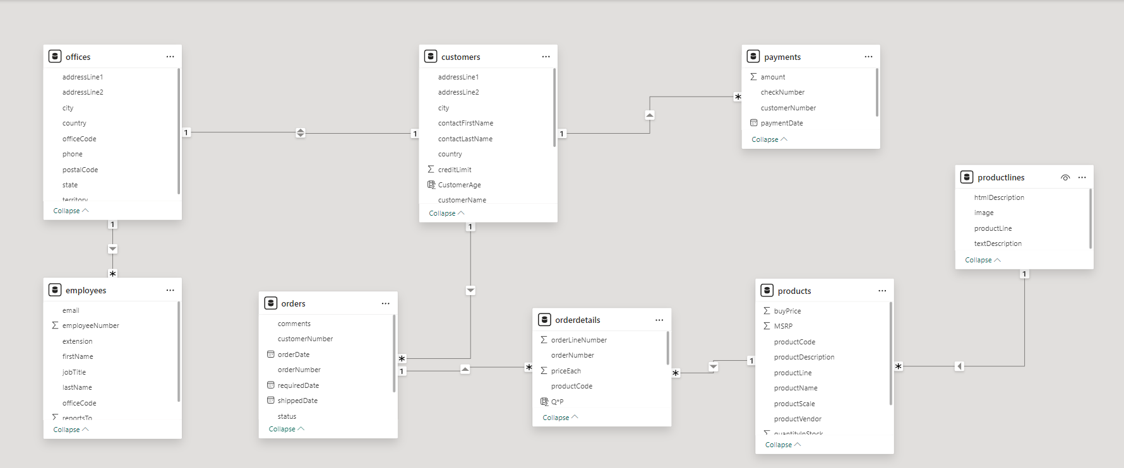
ER Diagram

Slide 6
POWER BI – PROBLEM STATEMENT

Slide 7
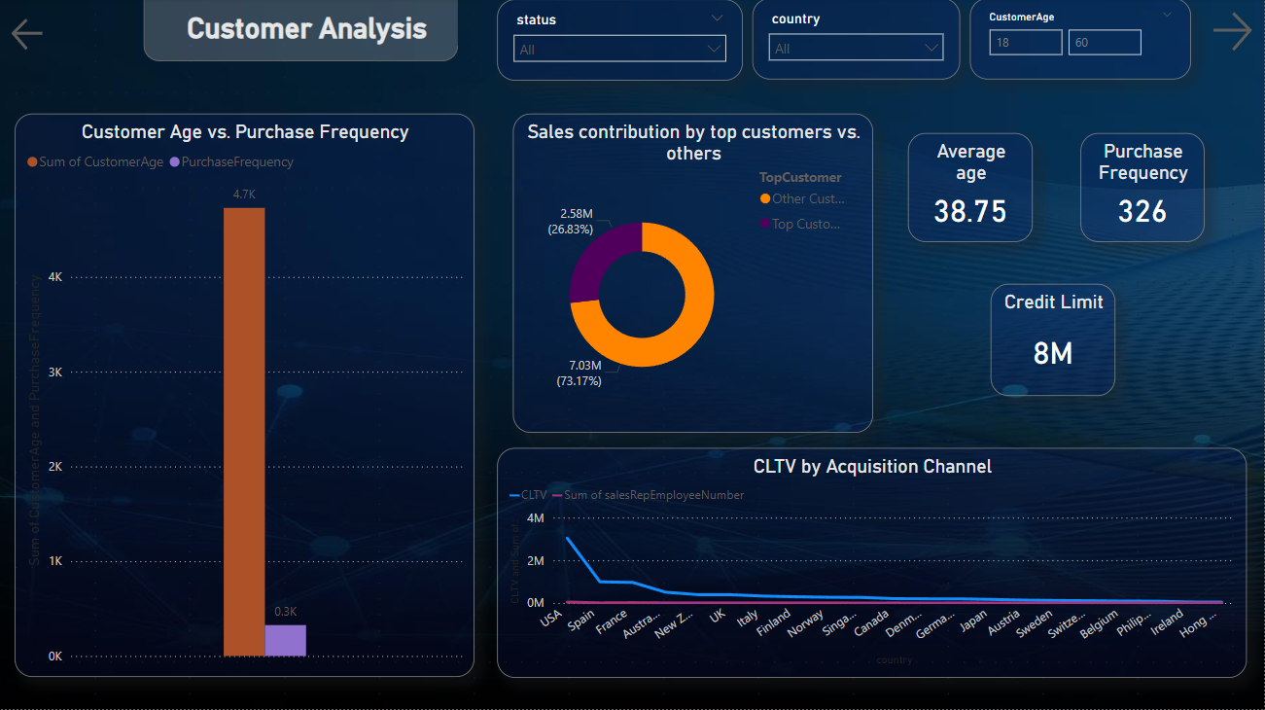

Slide 8
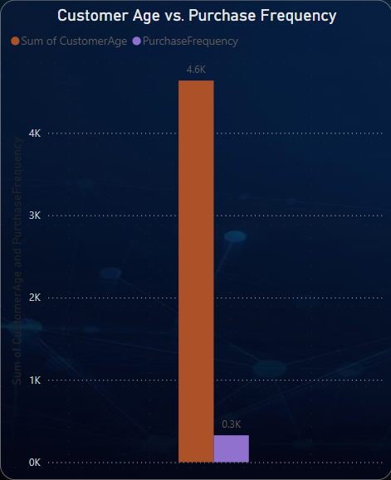
What is the correlation between customer age and purchase frequency?
The purchase frequency seems to be concentrated around customers aged 30-50.
Interestingly, there is no clear increase in purchase frequency with age, suggesting that buying habits
do not strongly correlate with age within the company's customer base.

Slide 9
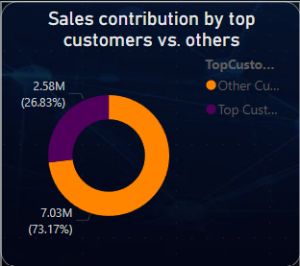
How does the sales performance of top customers compare to the rest?
The "Sales Contribution by Top Customers vs. Others" doughnut chart clearly illustrates that top customers account for the majority of sales, contributing 7.03M (73.17%) of the total revenue. In contrast, other customers contribute 2.58M (26.83%). This highlights that top customers are crucial to the company's sales, significantly outperforming the general customer base and demonstrating their influence on overall sales performance.

Slide 10
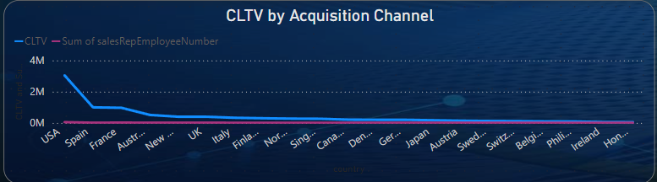
How does customer lifetime value vary for different customer acquisition channels?
The USA and Spain lead in Customer Lifetime Value (CLTV), with significantly higher values compared to other countries.
The trend drops off sharply after the top-performing regions, showing a wide disparity in CLTV between major and minor markets.
Channels contributing to regions like New Zealand and Germany see lower lifetime values.

Slide 11
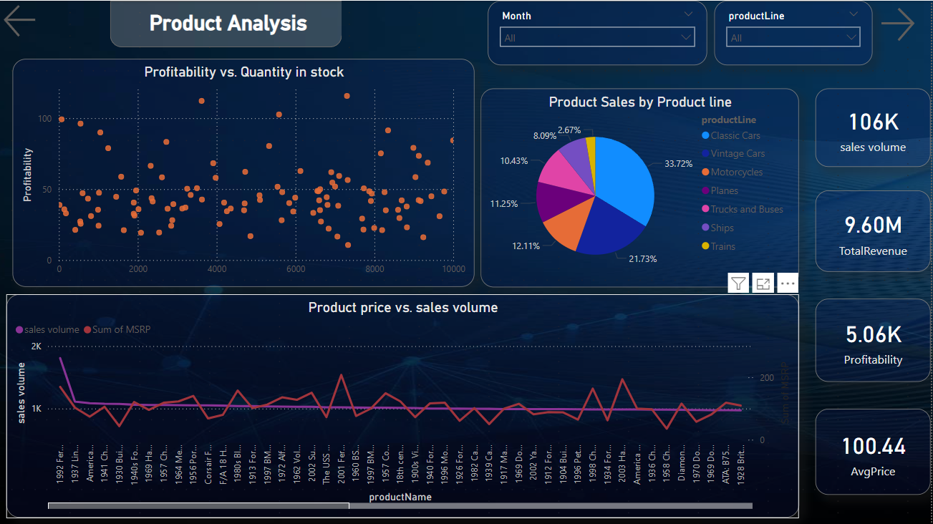

Slide 12
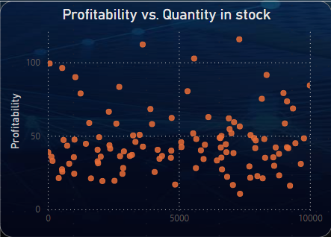
How does the profitability of different products compare based on their quantity in stock?
There is a moderate spread of profitability across different products based on their stock.
High profitability is not necessarily linked to high stock, as some products with lower stock quantities still demonstrate strong profitability.
This suggests strategic pricing or high demand for certain items regardless of their availability.

Slide 13
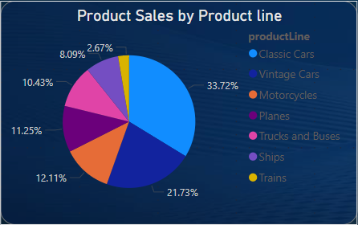
What is the distribution of product sales across different product lines?
Classic Cars dominate with 33.72% of the total sales, followed by Motorcycles at 21.73% and Planes at 12.11%.
Other categories like Trucks and Buses, Vintage Cars, and Ships make up smaller portions of the total sales.

Slide 14
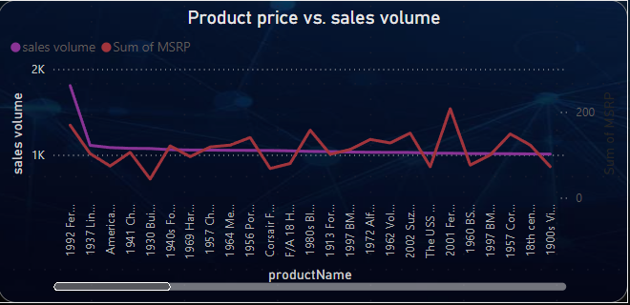
How does product pricing impact sales volume?
There seems to be an inverse relationship: as MSRP (Manufacturer's Suggested Retail Price) increases, sales volume tends to decrease.
Products with a lower price point tend to sell in higher volumes, indicating that customers are price-sensitive.
Notably, sales for products priced above a certain threshold experience a sharp drop.

Slide 15
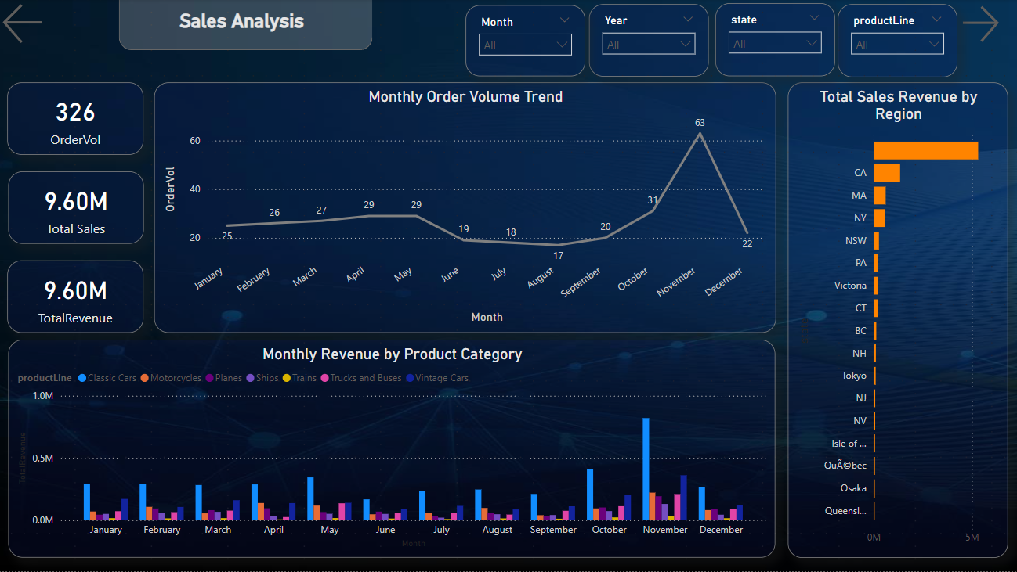

Slide 16
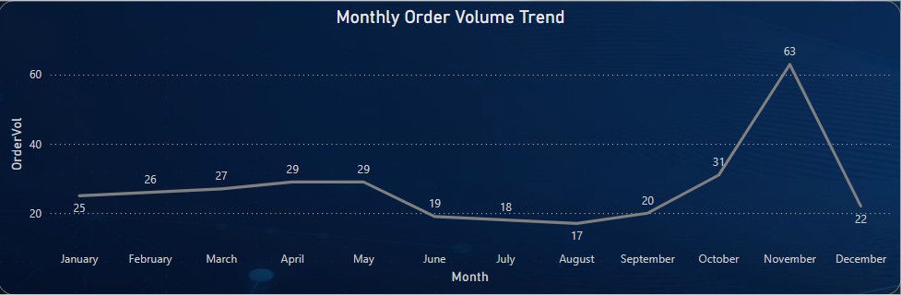
What is the trend in customer order volume over the past year?
From the "Monthly Order Volume Trend" graph, it is evident that customer orders show a gradual fluctuation throughout the year. January through June maintain a relatively steady order volume ranging from 20 to 30 orders each month. However, a sharp increase is noticeable in December, where the order volume peaks at 63, suggesting a seasonal surge in orders, possibly driven by holiday promotions or year-end demand. There is a slight dip during July and September, indicating off-peak periods.

Slide 17
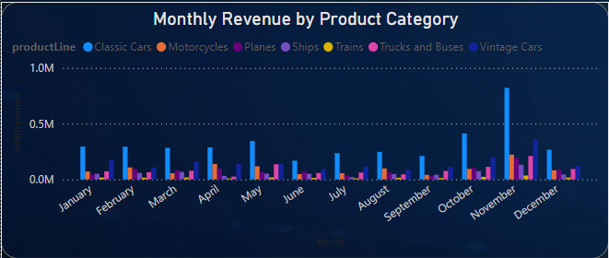
How does monthly revenue vary across different product categories?
The Monthly Revenue by Product Category chart shows distinct variations in revenue across product categories like Classic Cars, Motorcycles, Planes, and others.
Classic Cars consistently generate the highest revenue throughout the year, peaking around July and November.
Categories like Planes, Trucks and Buses, and Vintage Cars contribute less to the total monthly revenue.
Revenue across all categories tends to fluctuate month by month, with noticeable increases in revenue during July and December.

Slide 18
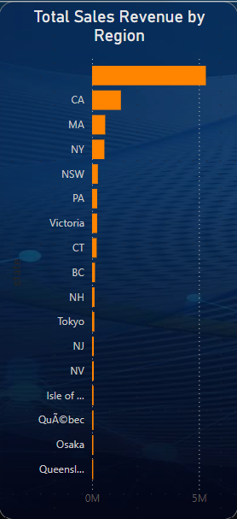
What are the top regions in terms of sales revenue?
From the "Total Sales Revenue by Region" bar chart, California (CA) leads as the top-performing region with over 5M in sales revenue. Massachusetts (MA) and New York (NY) follow, though their contributions are significantly smaller in comparison. California’s dominance in sales indicates its importance as a major revenue-driving region for the company, while other regions contribute more modest amounts.

Slide 19
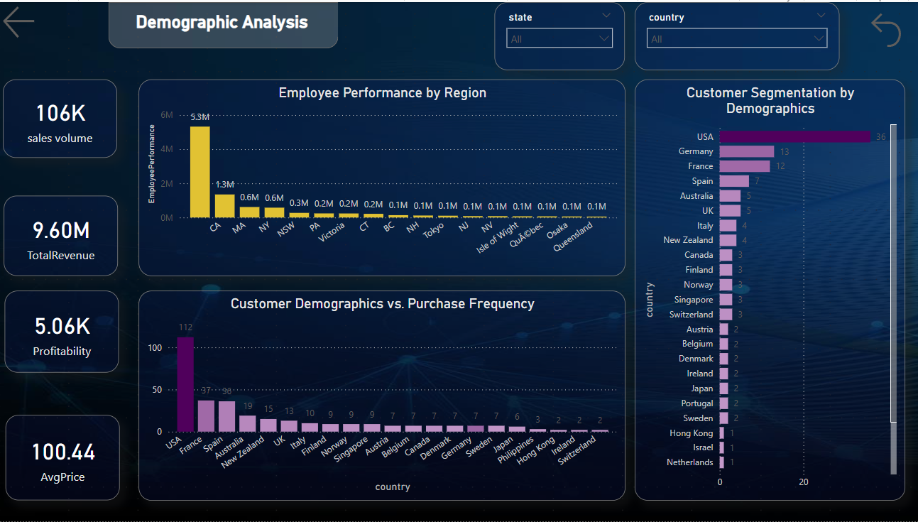

Slide 20
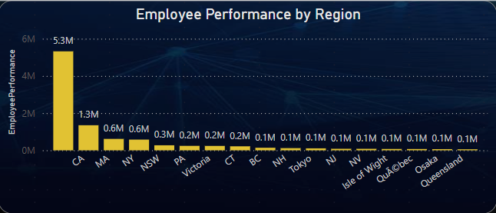
How does the performance of sales employees vary across different regions?
The "Employee Performance by Region" chart reveals a substantial difference in performance across regions. California employees generate the highest revenue, with a notable figure of 5.3M, while employees in regions like Massachusetts (1.3M) and New York (0.6M) also perform well but lag far behind California. Other regions like New South Wales (NSW), Pennsylvania (PA), and Victoria show significantly lower performance, which could suggest the need for improved sales strategies or resource allocation in those areas.

Slide 21
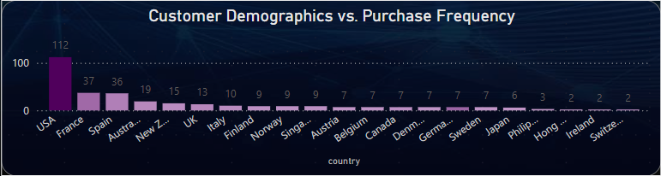
What is the correlation between customer demographics and purchase frequency?
There’s a clear correlation between regions with a larger customer base and higher purchase frequencies. For example, USA has both a high number of customers and higher purchase frequency.
Smaller customer bases in regions like Ireland, Poland, and Israel correspond to lower purchase frequencies, indicating that demographic size might influence how often customers purchase.

Slide 22
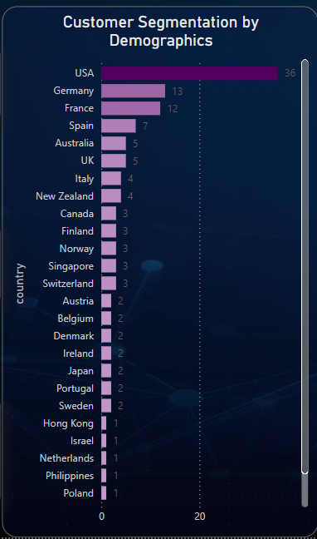
What is the distribution of customers across different demographic segments?
The USA has the highest number of customers, followed by Germany and France.
There is a clear concentration of customers from Europe and North America, with minimal representation from smaller countries like Japan, Singapore, and Israel.
This indicates that the company’s customer base is primarily from developed, high-income regions.

Slide 23
EDA - PROBLEM STATEMENT

Slide 24

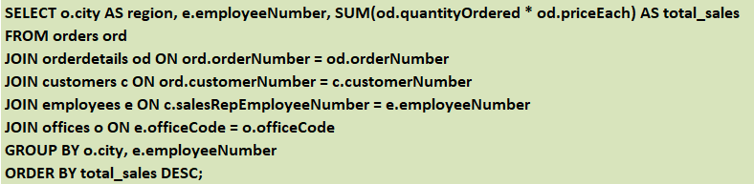
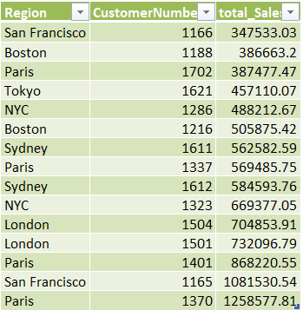
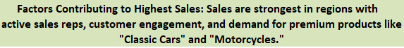
Q1 .Which factors contribute to the highest sales in a particular region?
QUERIES
OUTPUT
CONCLUSION
Notes:
Objective: Identify sales performance by region and associated factors.

Slide 25
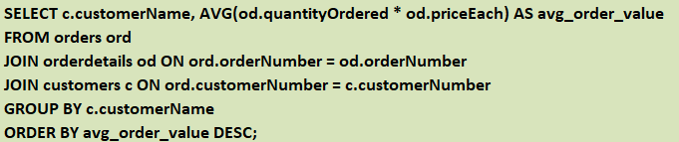
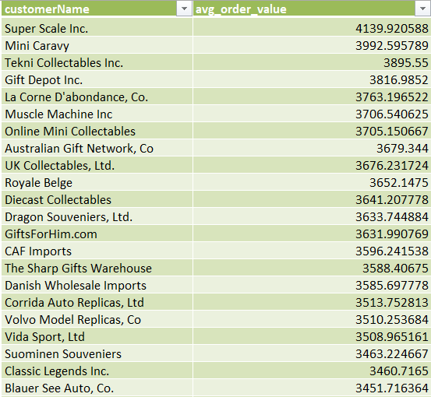
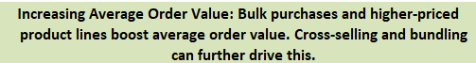
Q2. How can customer purchasing patterns be influenced to increase average order value?
QUERIES
OUTPUT SAMPLE
CONCLUSION
Notes:
Objective: Analyze average order value per customer and suggest strategies to increase it.

Slide 26
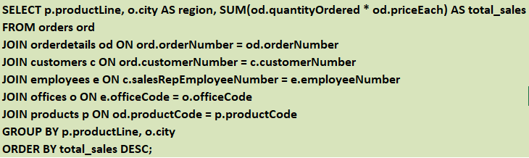
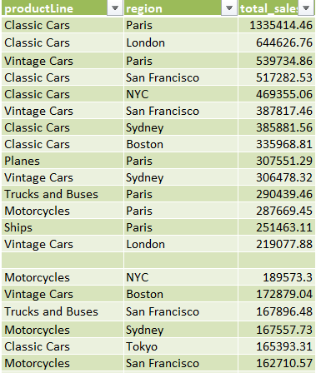
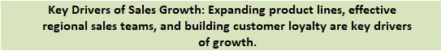
Q3. What are the key drivers of sales growth, and how can they be leveraged for future success
QUERIES
OUTPUT SAMPLE
CONCLUSION
Notes:
Objective: Identify product lines and regions contributing to sales growth.

Slide 27
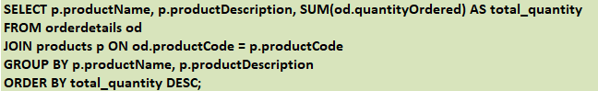
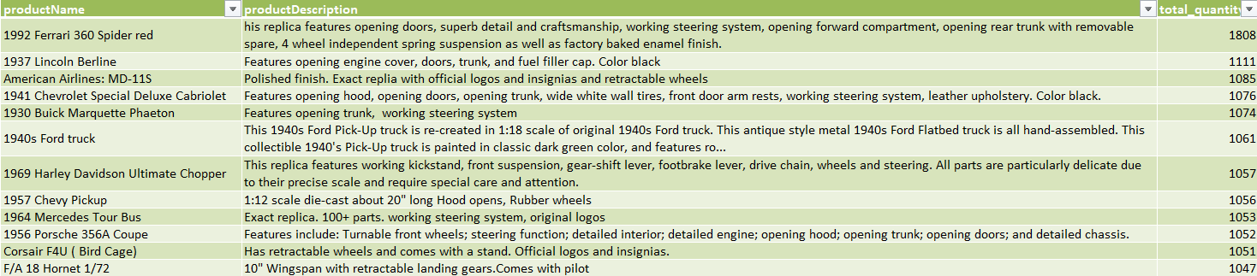
Q4. Which product features or attributes are most appealing to customers?
QUERIES
OUTPUT SAMPLE
CONCLUSION
Notes:
Objective: Identify top-selling products and their features.

Slide 28
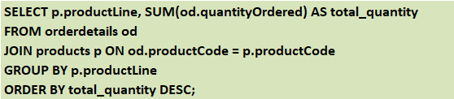
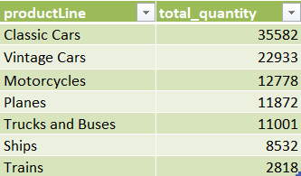
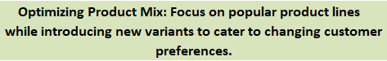
Q5. How can the product mix be optimized to cater to changing market demands?
QUERIES
OUTPUT
CONCLUSION
Notes:
Objective: Analyze product performance and suggest changes based on market demand.

Slide 29
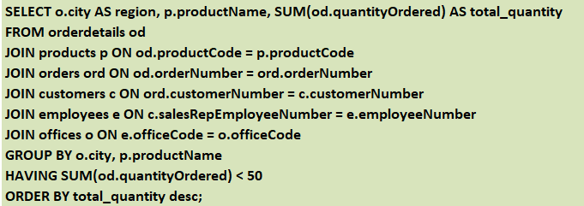
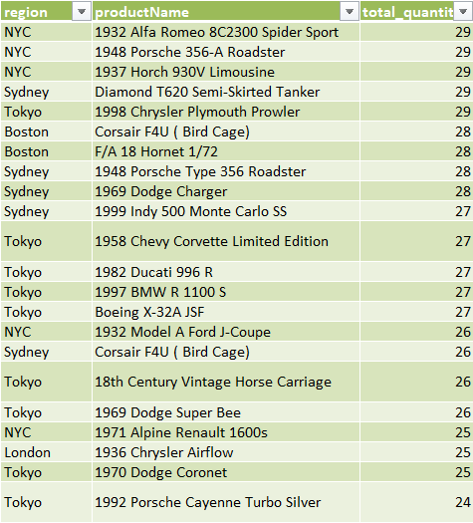
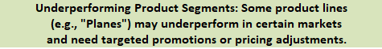
Q6. Are there any specific market segments where a particular product is underperforming, and how can it be improved?
QUERIES
OUTPUT SAMPLE
CONCLUSION
Notes:
Objective: Identify underperforming products in specific markets.

Slide 30
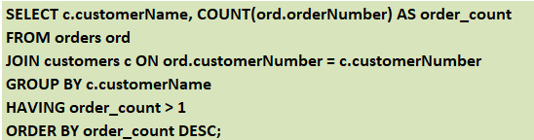
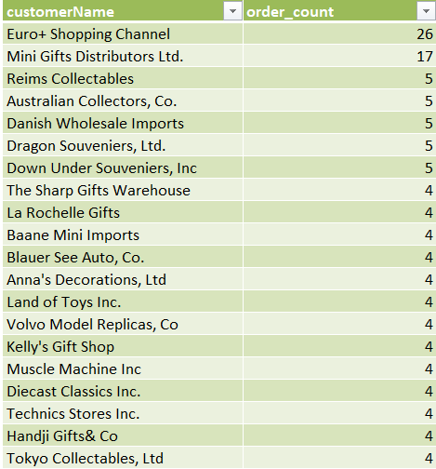

Q7. What are the main factors that influence customer loyalty and repeat purchases
QUERIES
OUTPUT SAMPLE
CONCLUSION
Notes:
objective: Analyze repeat purchase patterns.

Slide 31
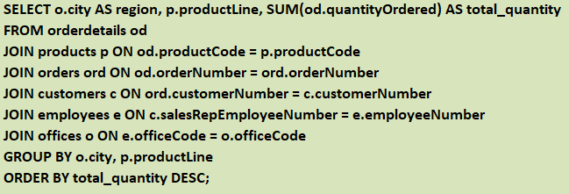
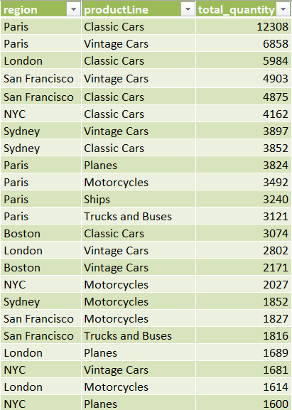

Q8. How do customer preferences differ based on geographic location, and how can marketing campaigns be customized accordingly?
QUERIES
OUTPUT SAMPLE
CONCLUSION
Notes:
Objective: Compare product preferences by region.

Slide 32
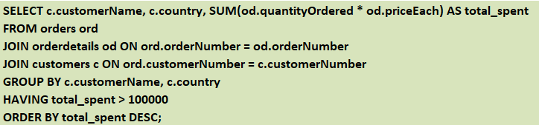
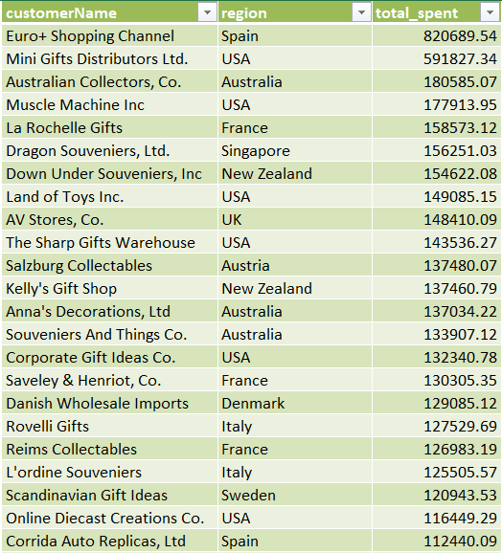
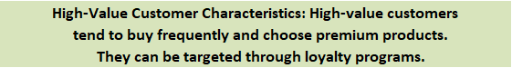
Q9. What are the characteristics of high-value customers, and how can similar customers be targeted for acquisition?
QUERIES
OUTPUT SAMPLE
CONCLUSION
Notes:
Objective: Identify high-value customers and their characteristics.

Slide 33
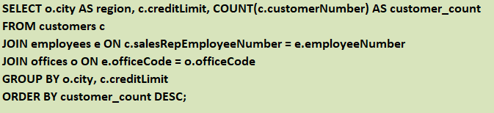
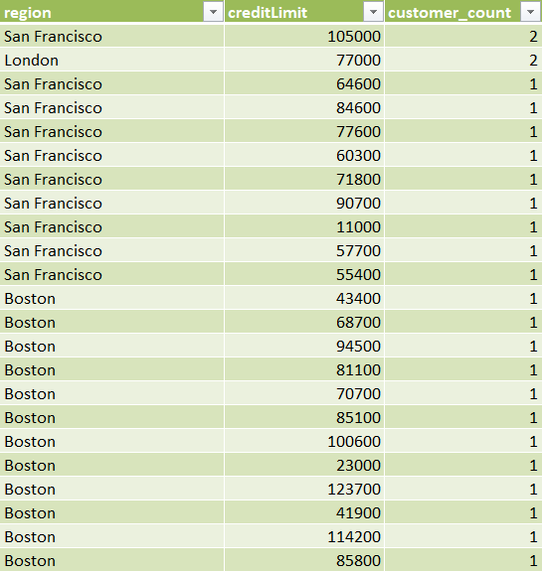
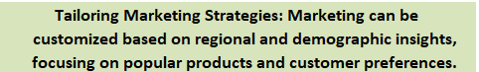
Q10. How can marketing strategies be tailored to target specific demographic segments in different regions?
QUERIES
OUTPUT SAMPLE
CONCLUSION
Notes:
Objective: Analyze demographic factors for marketing insights.

Slide 34
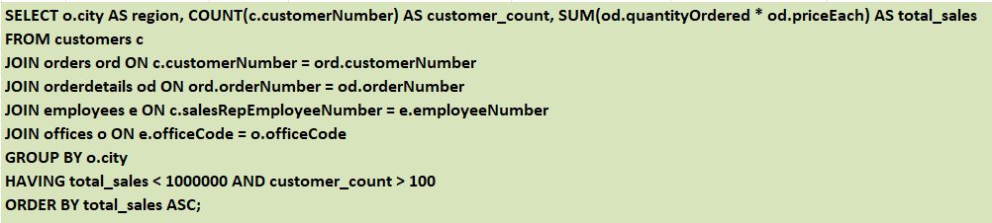
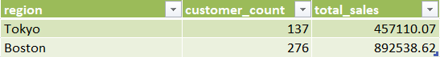

Q11. What are the potential untapped markets based on demographic indicators, and how can market penetration be increased?
QUERIES
OUTPUT
CONCLUSION
Notes:
Objective: Identify regions with low sales but high potential.

Slide 35



Q12. How do customer preferences and behavior differ based on demographic factors, and how can they be leveraged for personalized marketing campaigns?
QUERIES
OUTPUT SAMPLE
CONCLUSION
Notes:
Objective: Analyze customer preferences based on demographic factors like country or credit limit.

